Slide 1

Analog-to-Digital Converter (ADC) Project
Antonis– Circuit Design
Maksym – VHDL Coding
Maroš – Simulation & Testing
Jeannie – Documentation

Slide 2
Abstract
This project focuses on the design and implementation of a real-time Analog-to-Digital Converter (ADC) system using VHDL. The core objective is to digitize analog input signals from a potentiometer while minimizing signal instability and jitter, common challenges in real-world analog environments. To achieve this, the system incorporates a deadband quantization method with memory-less, hysteresis-based logic to filter out noise and produce a stable, step-sensitive digital output.
The digitized signal is used to drive both a 16-bit LED bar graph and four 7-segment displays, offering intuitive real-time visualization of the signal level. By eliminating minor fluctuations within the defined deadband region, the system ensures responsive yet stable behavior—ideal for applications where clean control signals are essential.
Developed entirely in VHDL, the system was thoroughly tested and simulated to validate its performance under real-time conditions. The final implementation demonstrates effectiveness in signal smoothing and user feedback, making it well-suited for signal visualization, control interfaces, and educational demonstration tools.
.

Slide 3
Main Contributions
- Developed a deadband quantization filter for noise-resistant digital output
- Designed VHDL modules to digitize, filter, and visualize analog signals
- Simulated the entire system using GTKWave for waveform verification
- Created a stable and accurate real-time ADC system for step-based input

Slide 4
Project Poster
View our A3 project poster for a detailed overview of the design, methodology, and results.
[Insert link or QR code here to view/download the full poster.]

Slide 5
Video Demo
Watch our short video presentation demonstrating the ADC system in action.
[Insert video link or QR code here. Include a screenshot or thumbnail if desired.]

Slide 6
Hardware Description
Our ADC system is implemented on an FPGA board with the following components:
- 12-bit XADC for digitizing analog voltage (0–1V)
- Filter unit using deadband quantization
- LED bargraph output (16 bits)
- 4-digit 7-segment display output
Top-Level Schematic:

Slide 7
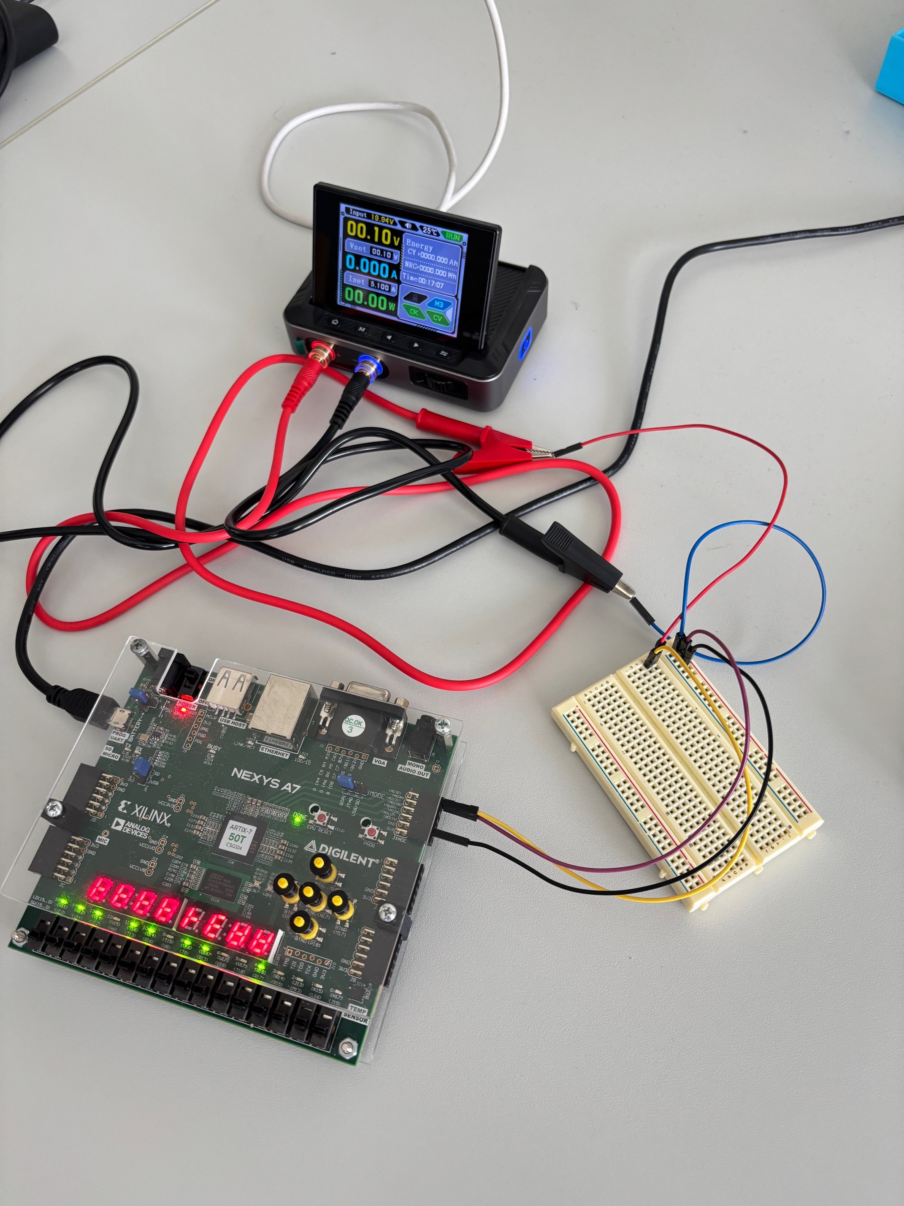
Hardware components

Slide 8
Software Description
The signal processing algorithm uses deadband quantization logic:
- Ignores minor fluctuations below a defined threshold
- Updates output only on significant change (>40 units)
Software Elements:
- VHDL Modules: fir_pkg.vhd, processing_unit.vhd, display_unit.vhd
- Testbench: sim_top.vhd simulates a 0–1V ramp input
Vivado
Nexys A7 50T
Flowchart/State Diagram:

Slide 9
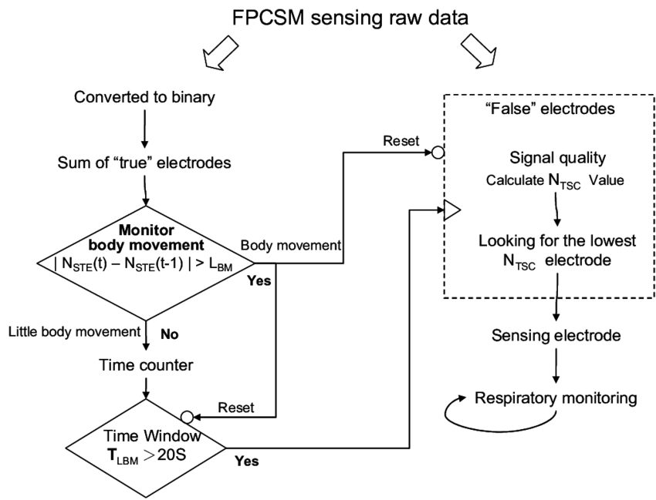
flowchart

Slide 10
Simulation Results
Simulation waveforms were generated using GTKWave.
- Verified correct digital conversion of analog signal
- Checked LED and 7-segment display outputs for stability and accuracy
- Filter successfully ignored jitter and small fluctuations

Slide 11
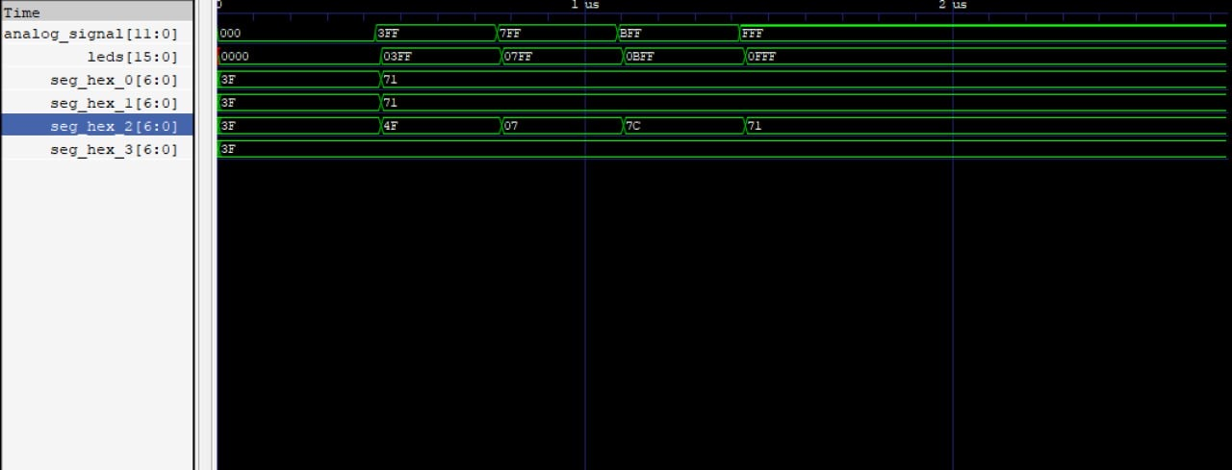
Simulation diagram
Simulation: ADC Output and Display Signals

Slide 12
References
- VHDL documentation: https://www.vhdl.org
- FPGA development boards: Intel/Altera or Xilinx
- GTKWave waveform viewer: http://gtkwave.sourceforge.net/
- Project simulation tools and documentation
- Online forums and datasheets (e.g., Digikey, Mouser)

